Slide 1
Video Game Sales Dashboard Project
Internship Submission
Created by: Praveen kumar R

Slide 2
Objective & Tools Used
🎯 Objective:
Analyze global video game sales, identify revenue trends by region, and visualize KPIs.
🛠️ Tools Used:
- Excel: For initial data prep and USD to INR conversion
- Power Query: For data cleaning and transformation
- Power BI: For dashboard creation and interactivity

Slide 3
Data Processing
- Converted all sales values from USD to INR
- Aggregated sales by Region, Publisher, Genre, and Year
- Cleaned and modeled data using Power Query in Power BI

Slide 4
Dashboard Highlights
✔️ KPIs:
- Total Revenue, Avg Revenue, Regional Sales
✔️ Visuals:
- Donut chart, Gauge chart, Line area chart, Table
✔️ Filters:
- Genre filter, Navigation menu
✔️ Design:
- Dark theme with neon color scheme
- Custom logo and layout

Slide 5
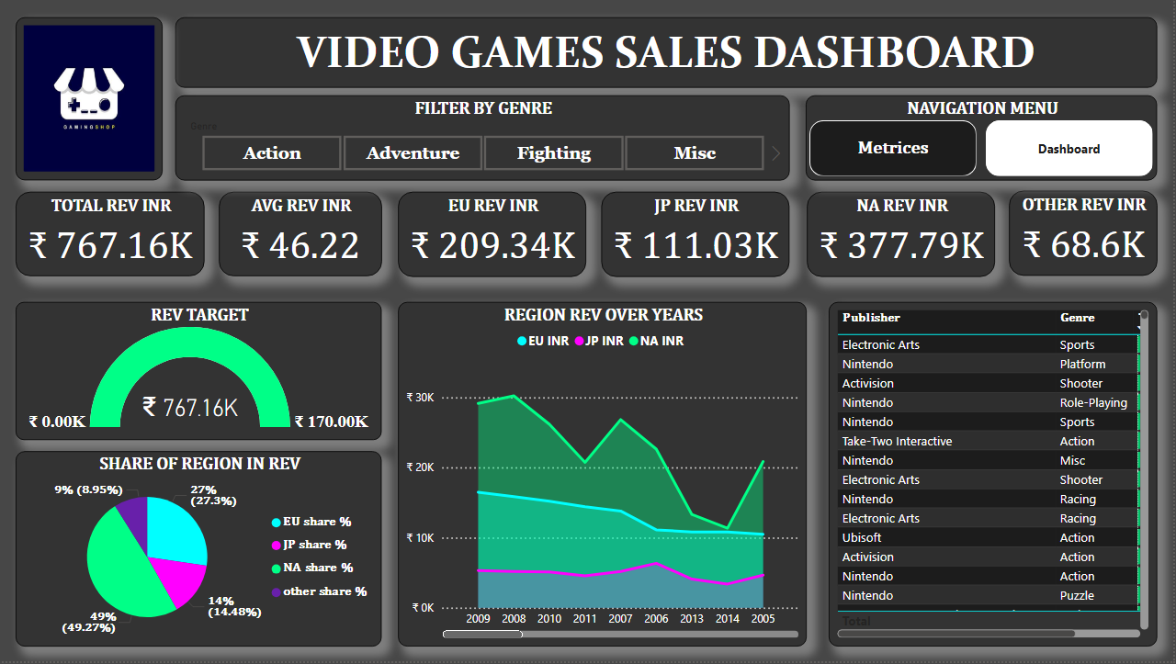

Slide 6
Submission Details
📁 Files Submitted:
- Dashboard.pbix
- Dashboard.png
- README.txt
👨‍💻 Created By: Praveen kumar R
Role: Data Analyst Intern
Date: August 2025

